Slide 1

SIMULATION STUDY ON SIGN TEST
Suchandra saha
Partha pratim das
ABHRADIPTA ghosh

Slide 2

CONTENT
Brief Description of Sign Test
Study of Simulated Size and Power
Asymptotic Behaviour
A real life Testing Problem

Slide 3

BRIEF DESCRIPTION
OF
SIGN TEST

Slide 4
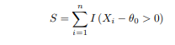
Description
Suppose that we have a random sample X1, X2, . . . Xn of size n from a continuous distribution F (x − θ).;where θ is unknown and F (.) is such that F (0) = 1/2 .
We also assume that the population has unique median.
Under these minimal assumptions, suppose we are interested in testing the null hypothesis, H0 : θ = θ0(known) against any of the alternatives H1 : θ > θ0.
We define the sign statistics as,

Slide 5
Procedure
We first selected a known continuous probability distribution having CDF F(.). F(.) is such that it satisfies the conditions:
1. F is of absolute continuous CDF.
2. F(0) = 1 /2 .
Using R programming language, we then simulated random samples X1, X2, . . . Xn of fixed size n from the probability distribution with CDF F (x − θ), for different choices of θ (like 0, 0.1, 0.2, etc). Our null hypothesis of interest is H0 : θ = 0 against the alternative H1 : θ > 0 (i.e., for simplicity we take θ0 = 0).

Slide 6

STUDY
OF SIMULATED SIZE AND POWER
FOR
SIGN TEST

Slide 7

Size For Sign Test
Step 1: we simulate sample data from continuous distribution F , and perform Sign test as described earlier.
Step 2 : We repeat the test procedure for several sample sizes and make a comparison for corresponding sizes.

Slide 8
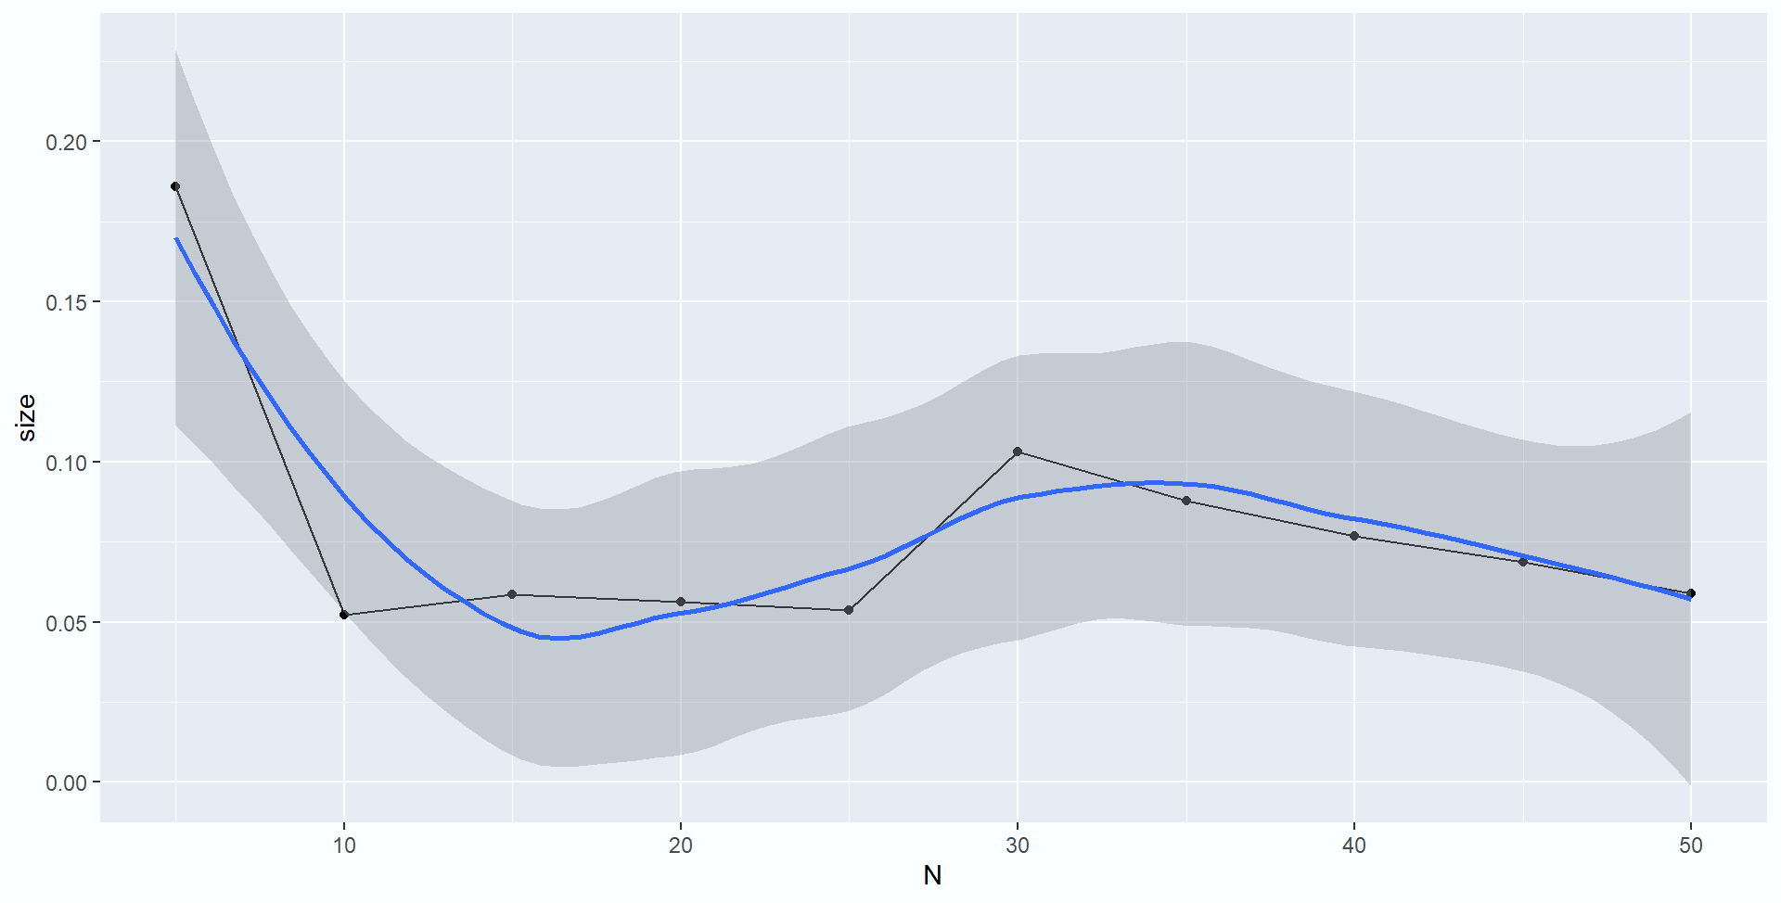
X~N(0,1)
m=1000
n=5,10,..,50
Here we see as sample size increases from 5 to 50, the size converges to 0.05

Slide 9
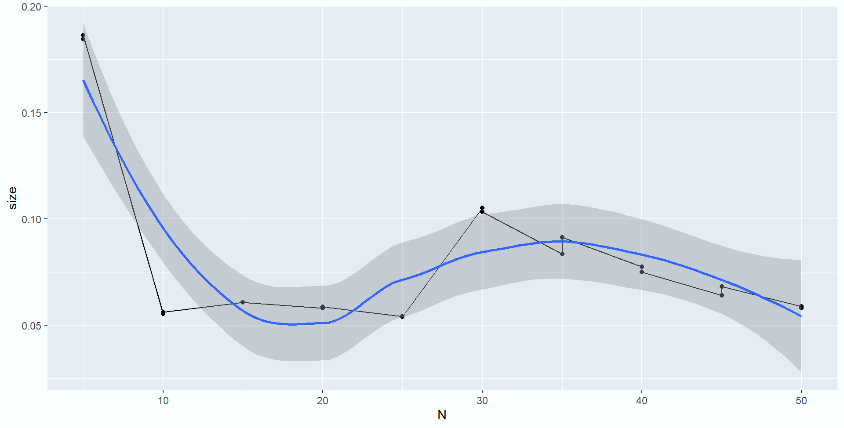
X~Unif(-1,1)
m=1000
n=5,10,..,50
We can see as sample size increases, size gradually is tending to 0.05

Slide 10
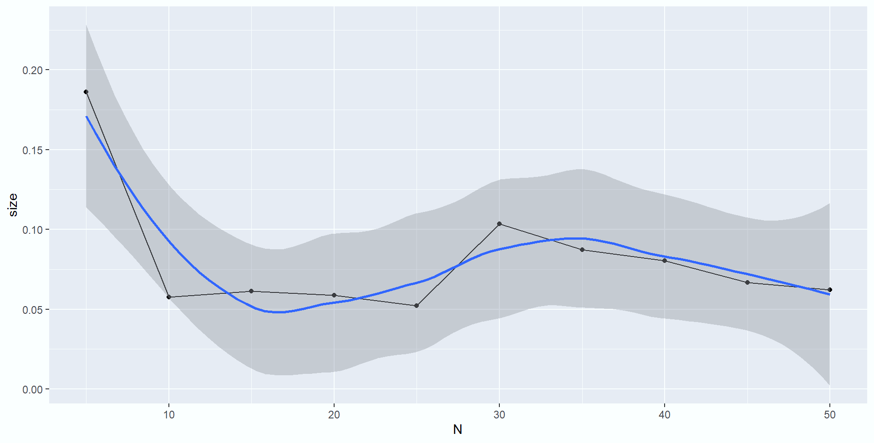
X~Logistic(0,1)
m=1000
n=5,10,..,50
Here also with the sample size increases from 5 to 50, the size converges to 0.05

Slide 11
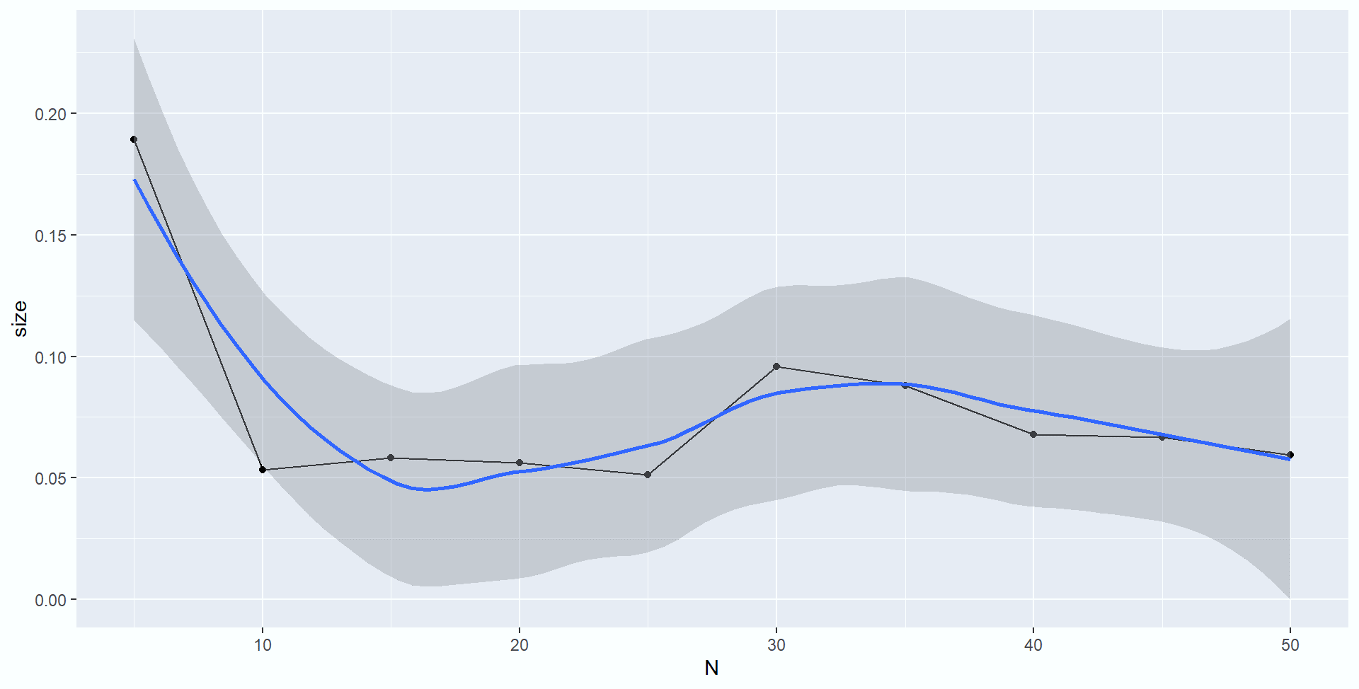
X~DE(0,1)
m=1000
n=5,10,..,50
Here also for Laplace distribution we see as sample size increases from 5 to 50, the size converges to 0.05

Slide 12
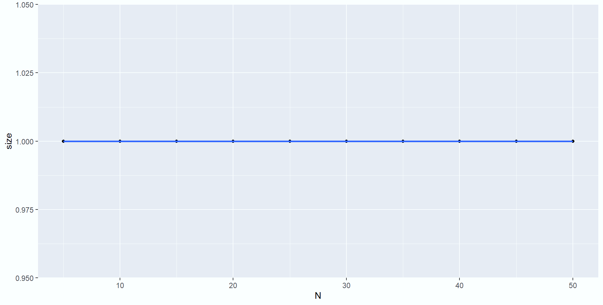
X~SE(0,1)
m=1000
n=5,10,..,50
For shifted exponential distribution all value are positive so here sign test will always give the size equals to 1, as most of the cases we reject our null hypothesis

Slide 13
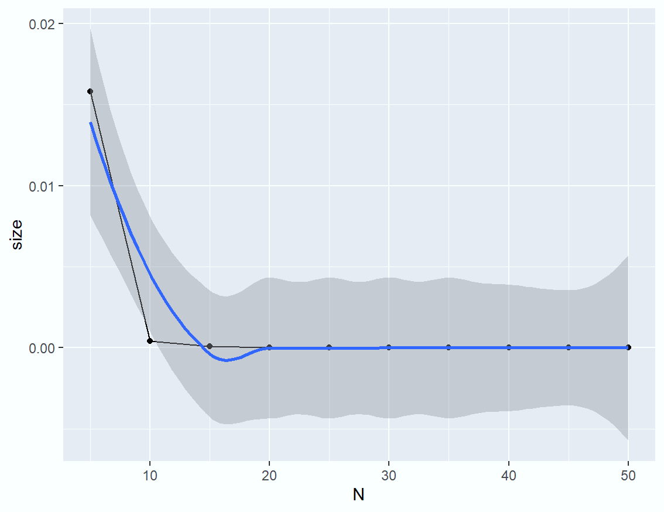
X~ Uniform(-3,1)
m=1000
n=5,10,..,50
Size goes to zero apparently as n increases, from the fact the proportion of positive value decreases considerably i.e type I error is less

Slide 14

Power Curve for Sign Test :
Step 1: We simulate the values of power function from the corresponding Sign Test under certain distributions.
Step 2: We plot the power curves and make a comparison over several sample sizes.

Slide 15
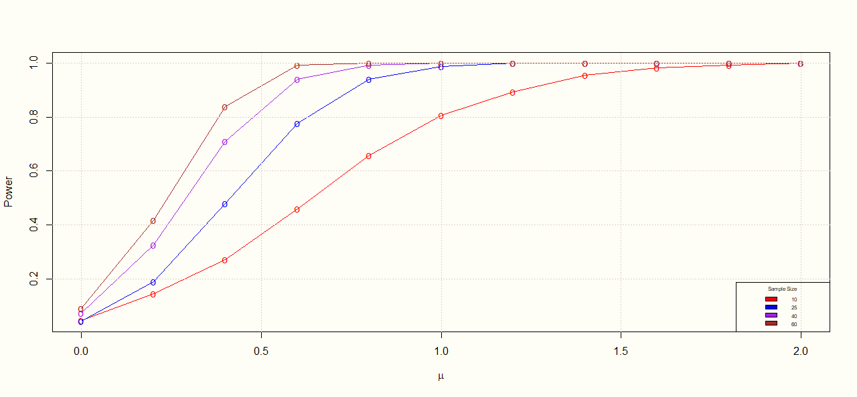
N(µ,1)
In the normal distribution as value of µ is increasing we are more deviating from our null hypothesis assumption, So power of the test increases.

Slide 16
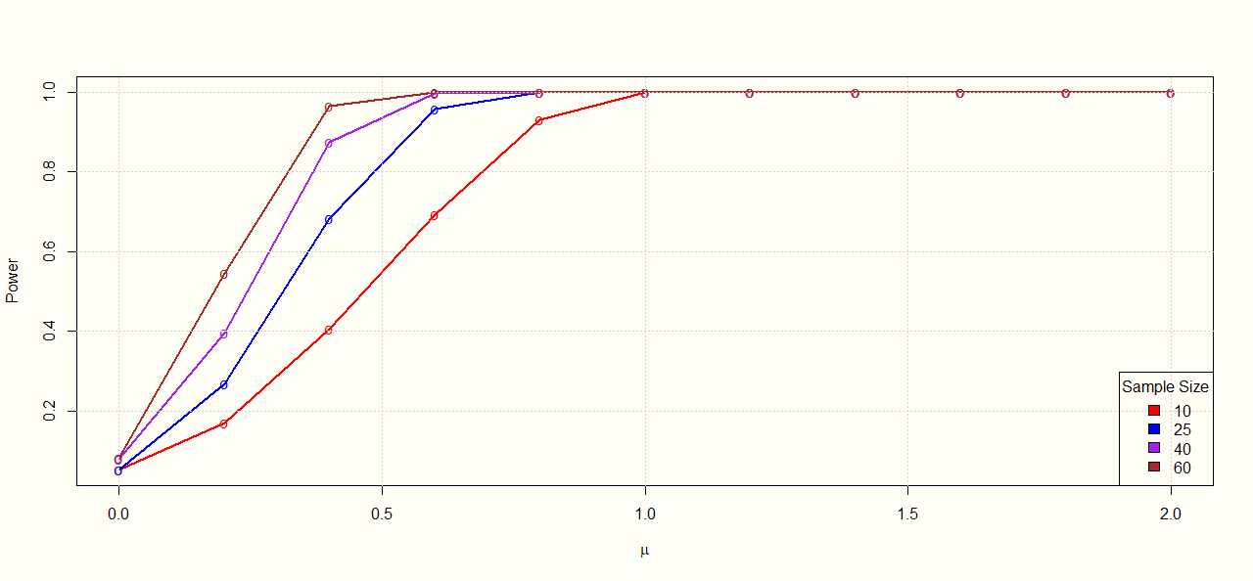
Unif(µ-1, µ+1)
The same thing we can see for uniform distribution for the sample size n=10,25,40,60

Slide 17
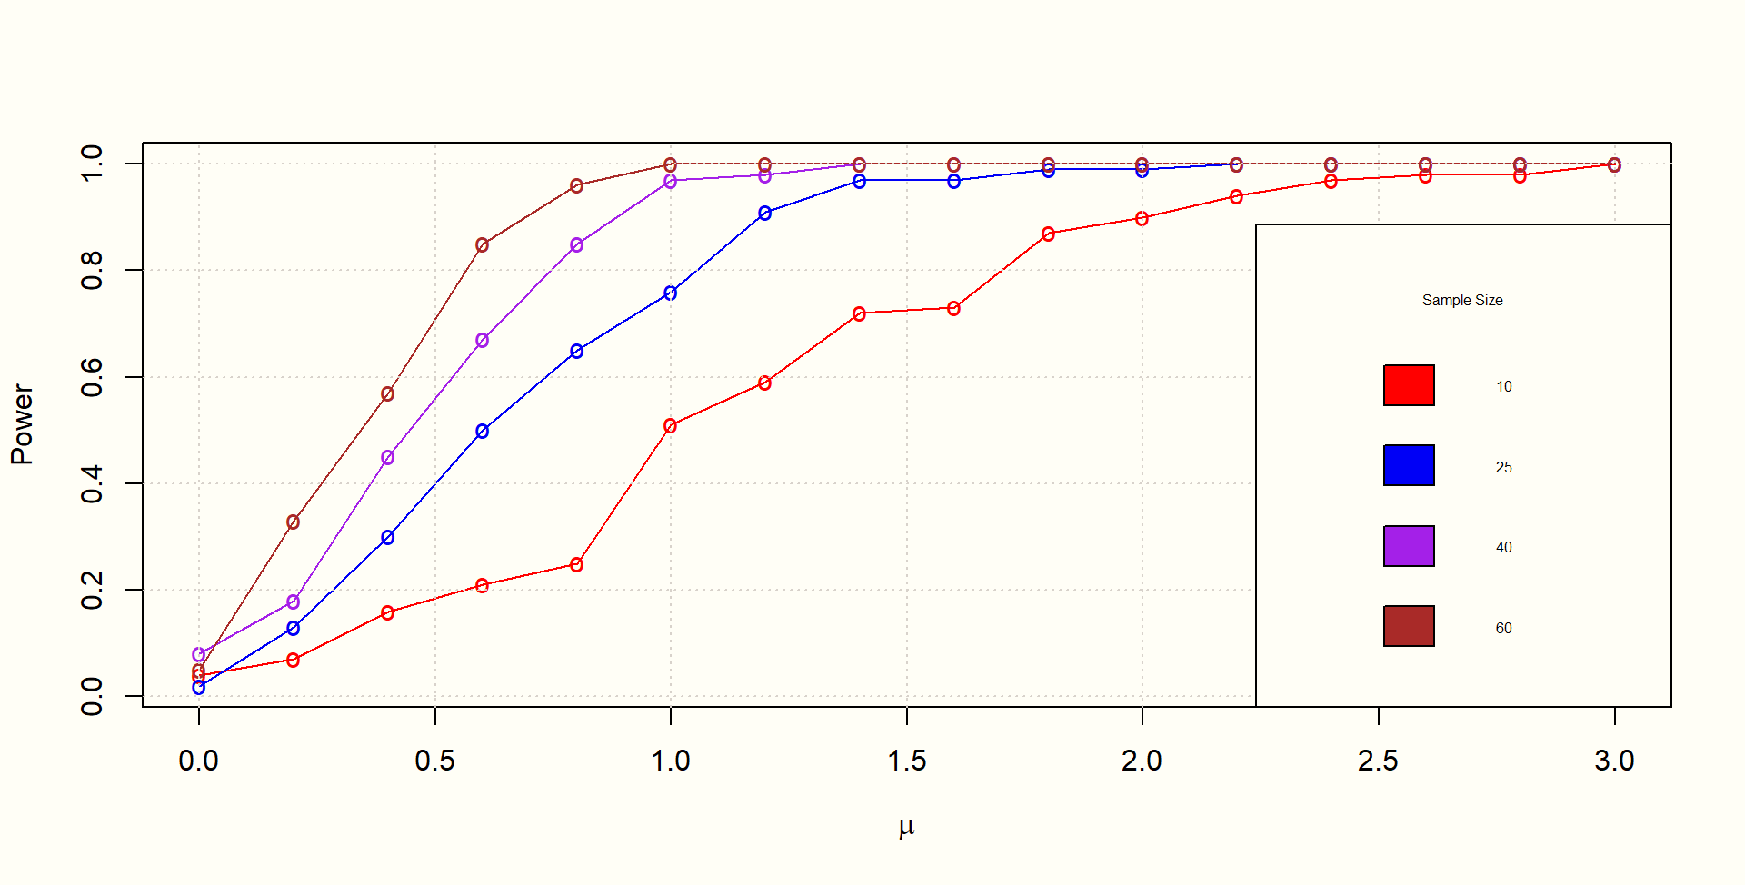
Logistic(µ,1)
For logistic distribution also power will go to 1 as n increases but at slower rate.

Slide 18
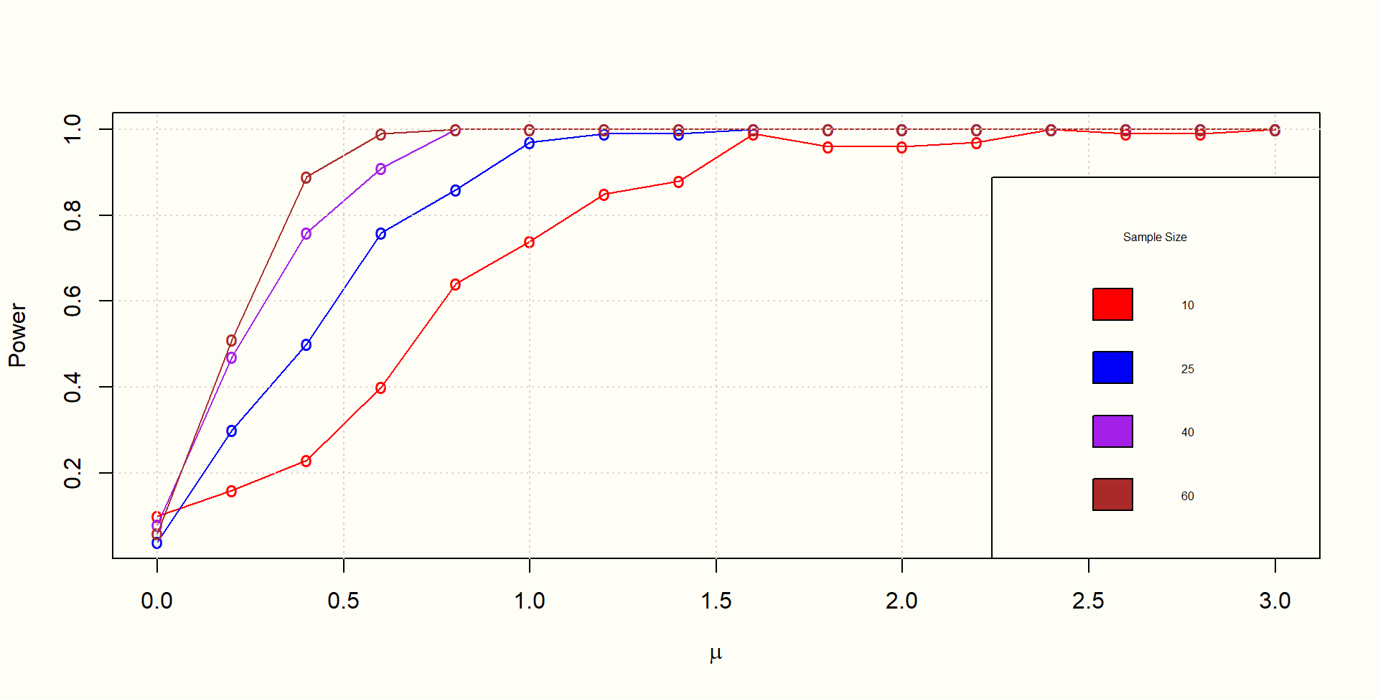
DE(µ,1)
By the same logic we will say power will goes to 1 as n increases

Slide 19
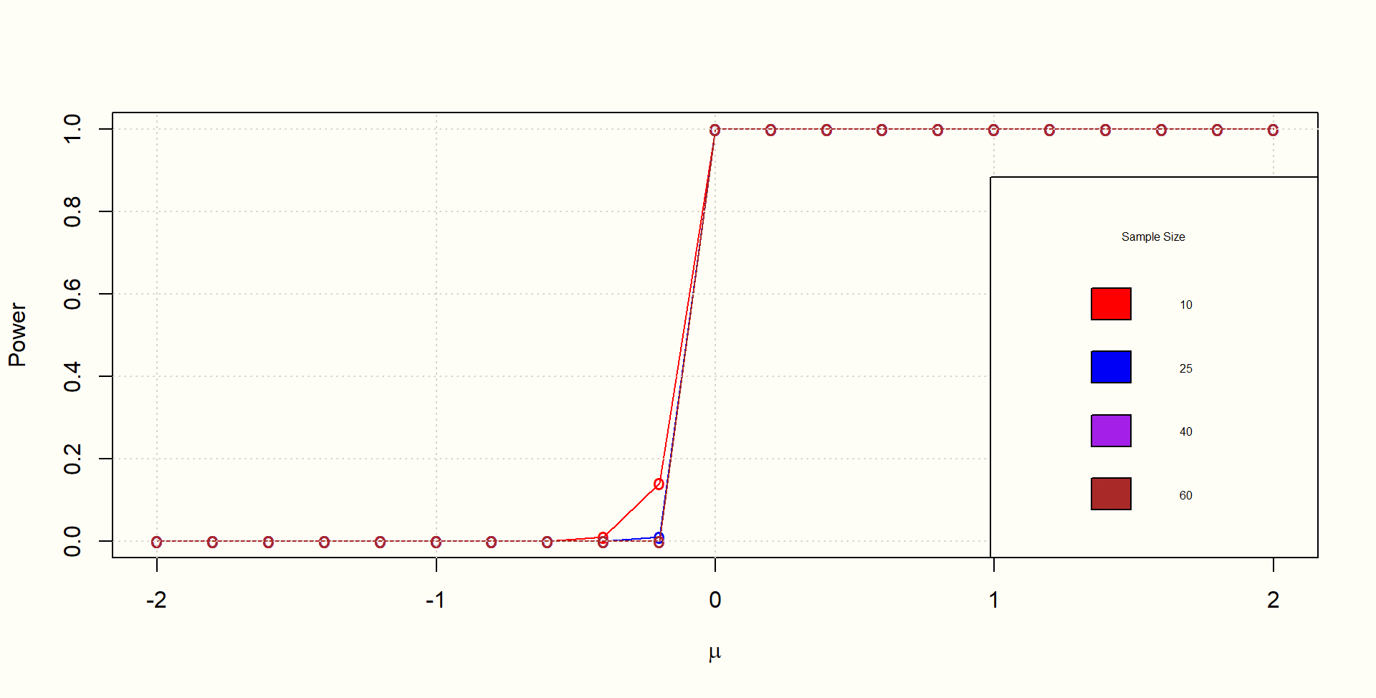
SE(µ,1)
When the value of mu is negative the power is 0, at mu 0 the power Abruptly goes to one.

Slide 20
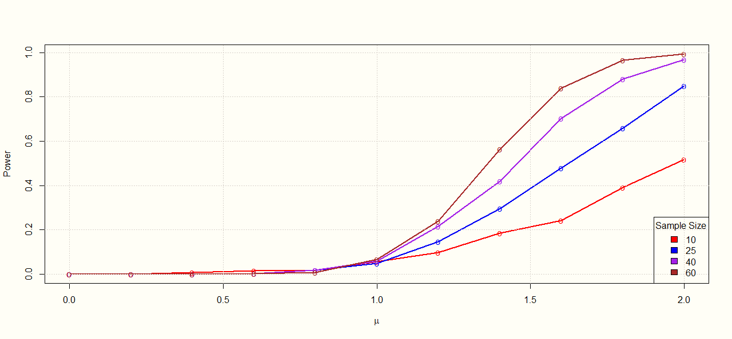
Unif(t-3,t+1)
Taking different interval in uniform distribution, if we want to check the power of the distribution it also goes to 1, depending on the interval of the uniform distribution the rate of power convergence will change

Slide 21
DISTRIBUTION FREE NATURE OF SIGN STATISTIC :
Step 1 : We simulate n observations under a continuous distribution F and obtain the value of Sign Statistic.
Step 2: This is repeated m times and Relative Frequency plot is obtained from the data.
Step 3: It is graphically verified that under different underlying null distributions, the density plot does not change its basic nature(size, shape etc.)

Slide 22
NULL DISTRIBUTION IS F= N(0,1)

Slide 23
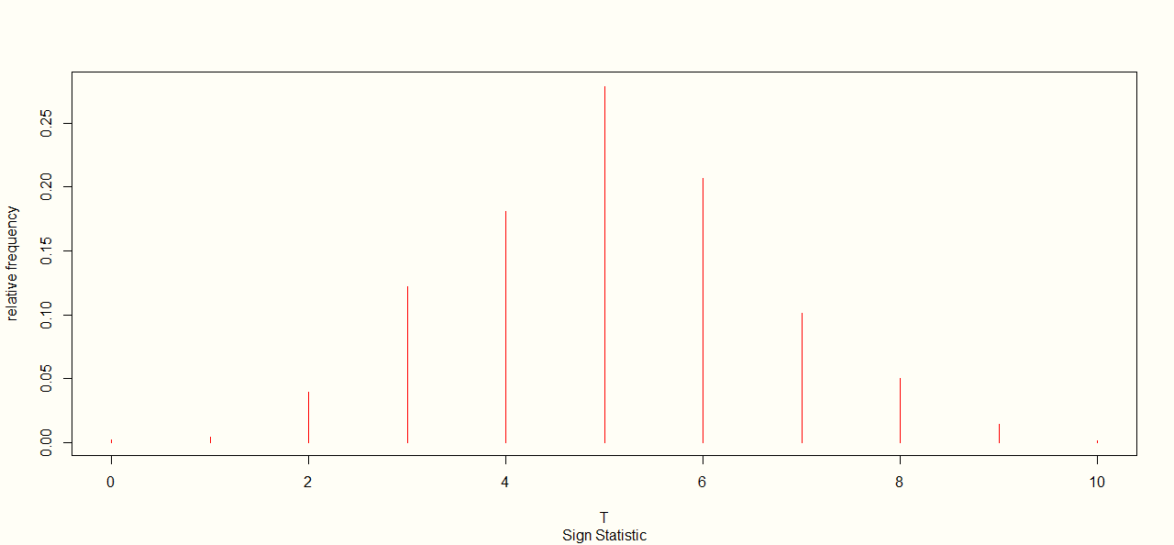
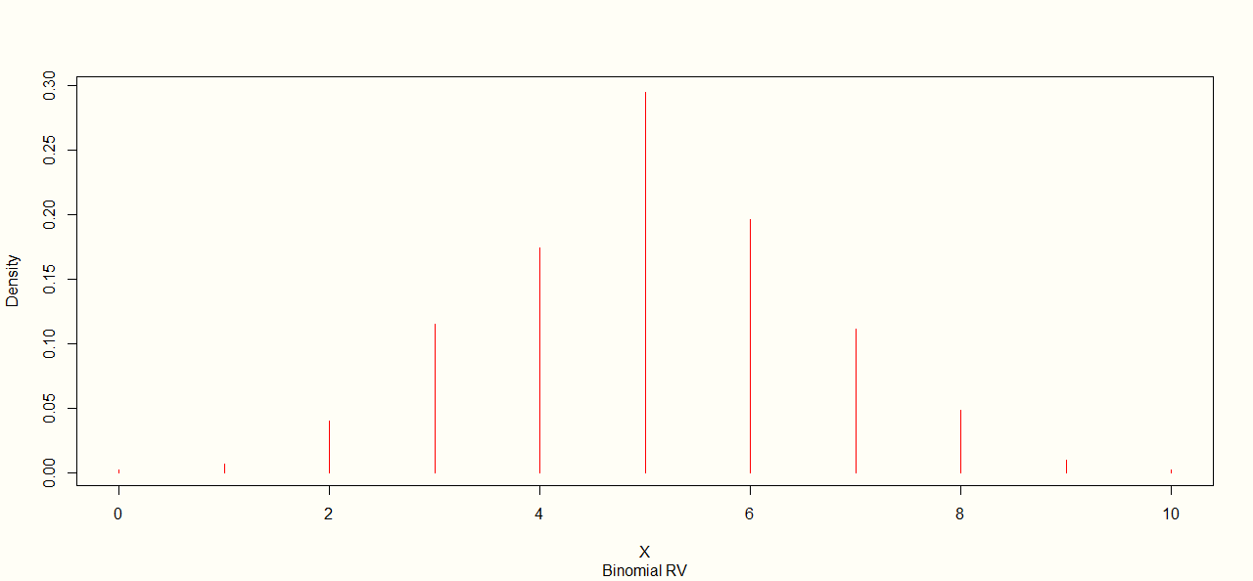
n=10
Relative frequency plot of sign statistic is reasonably very closely to the density plot of binomial distribution.

Slide 24
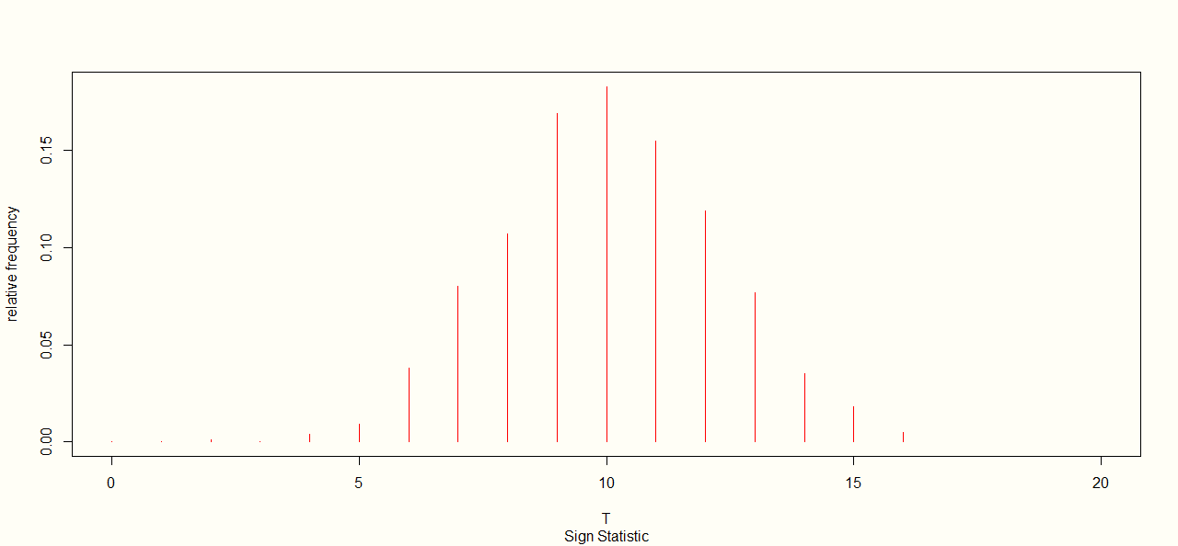
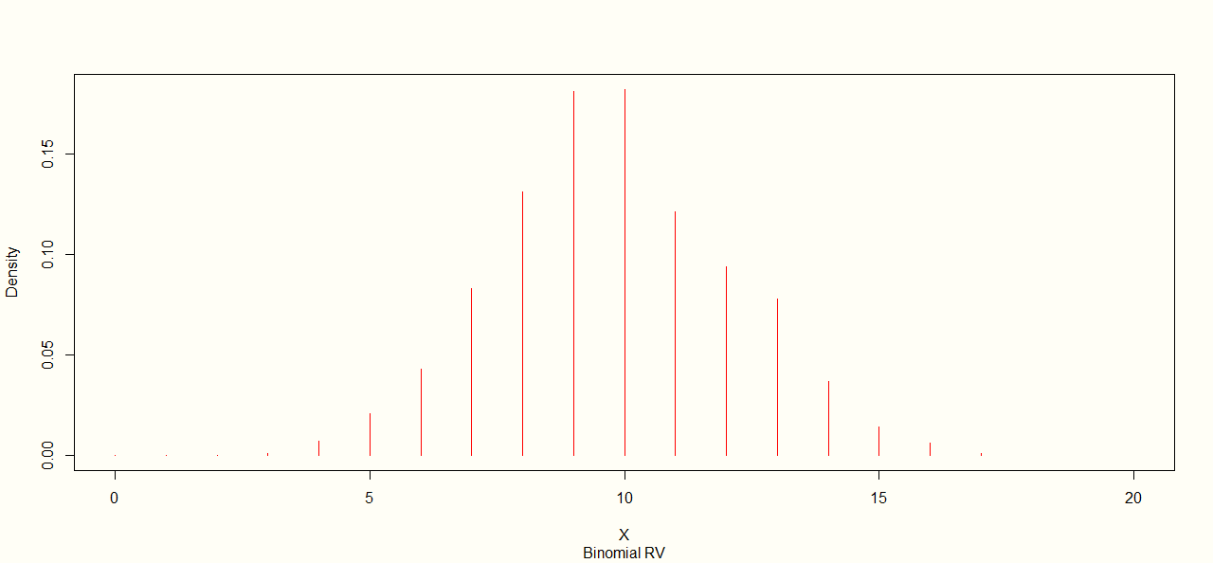
n=20

Slide 25
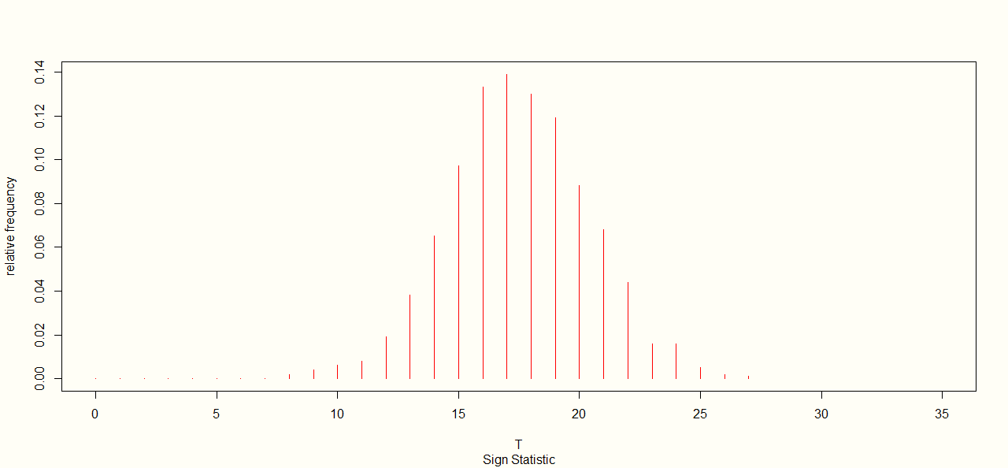
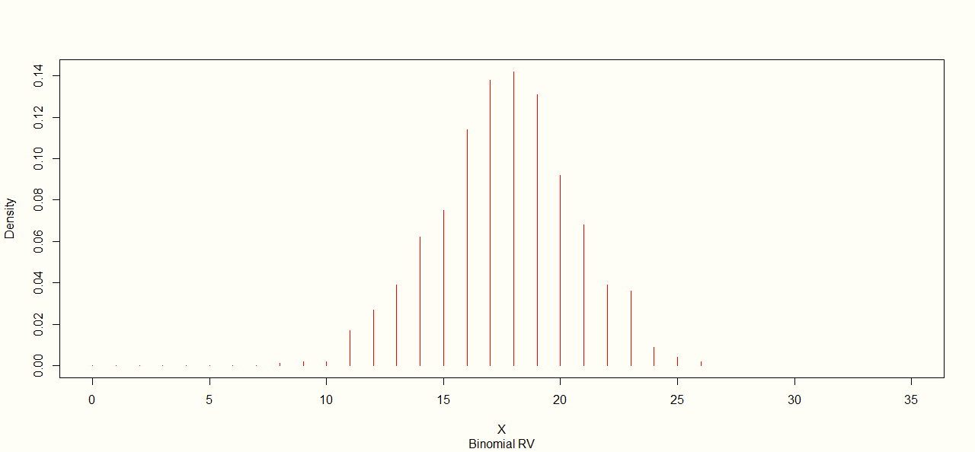
n=35
So we can see with the increase of n relative frequency plot of the normal density converge to density plot of binomial distribution.

Slide 26
NULL DISTRIBUTION IS F= DE(0,1)

Slide 27
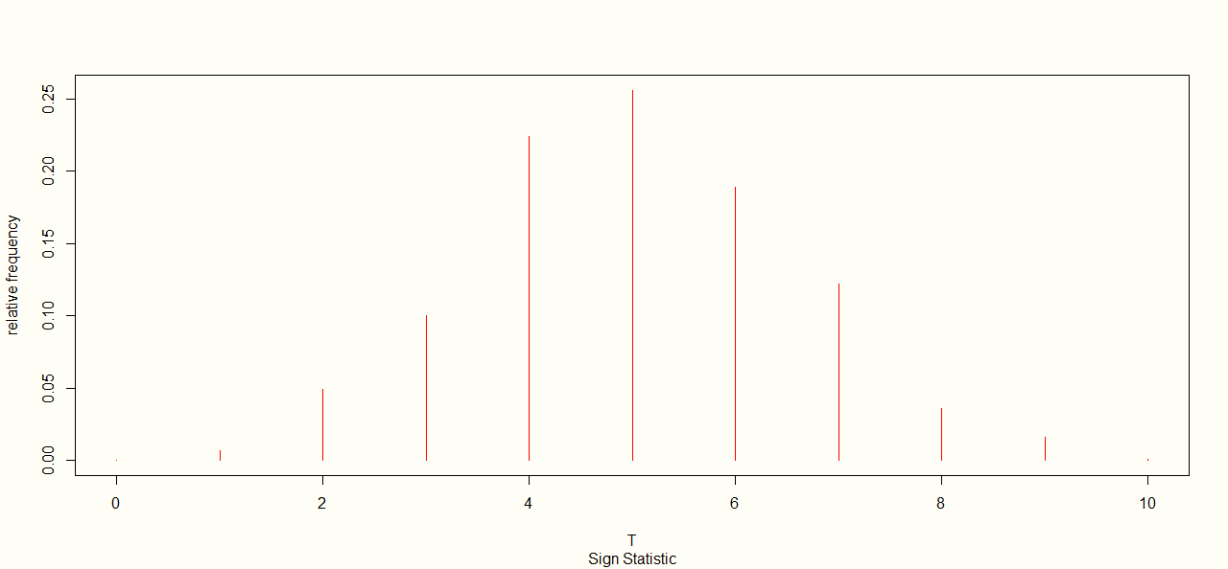
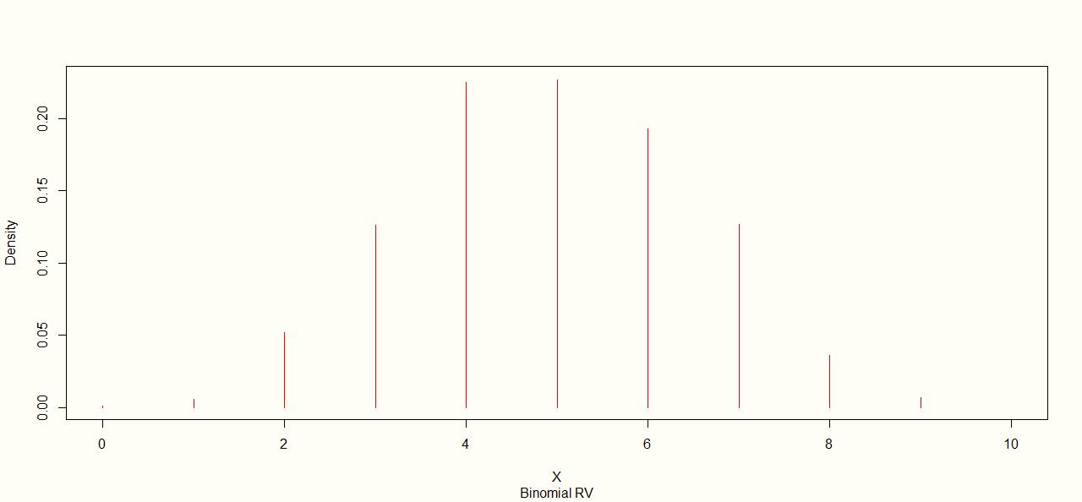
n=10

Slide 28
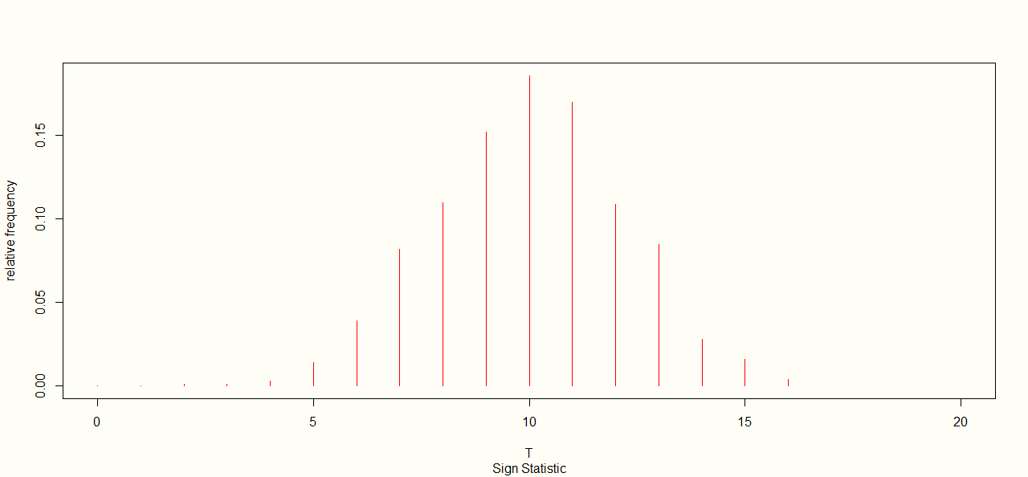

n=20

Slide 29
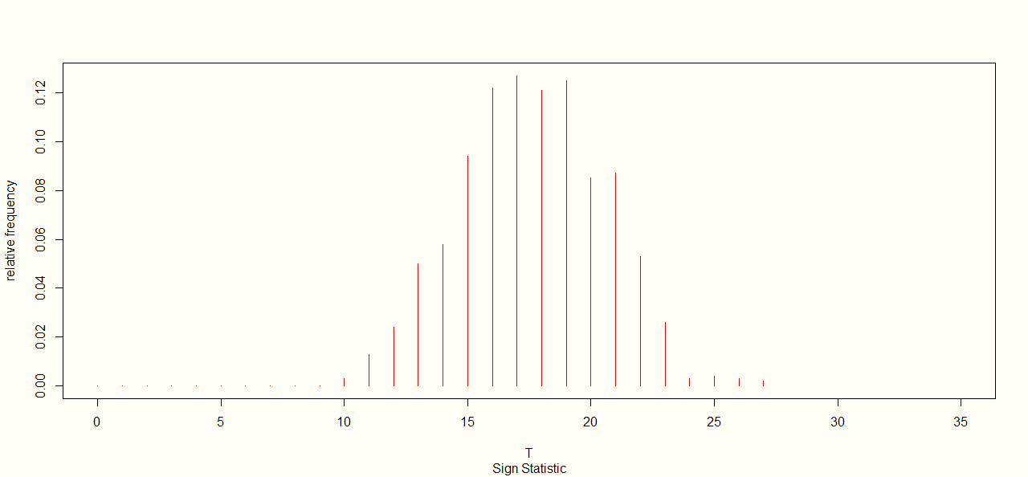
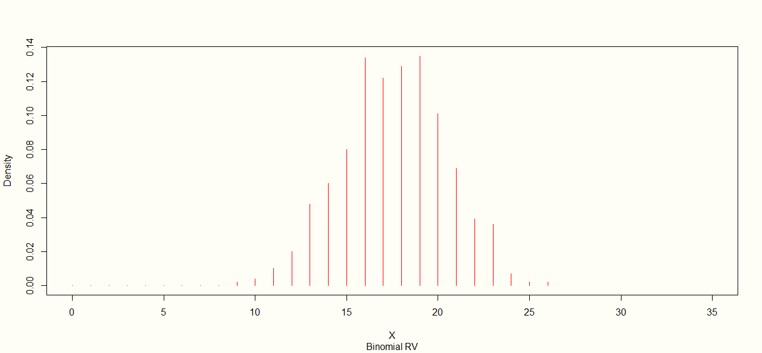
n=35

Slide 30
NULL DISTRIBUTION IS F= SE(0,1)

Slide 31
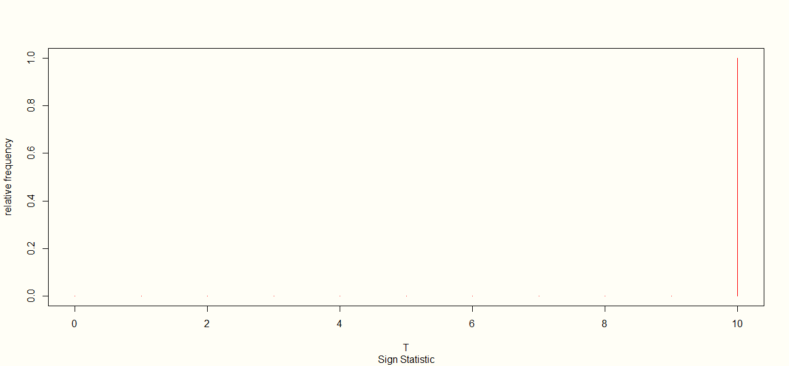
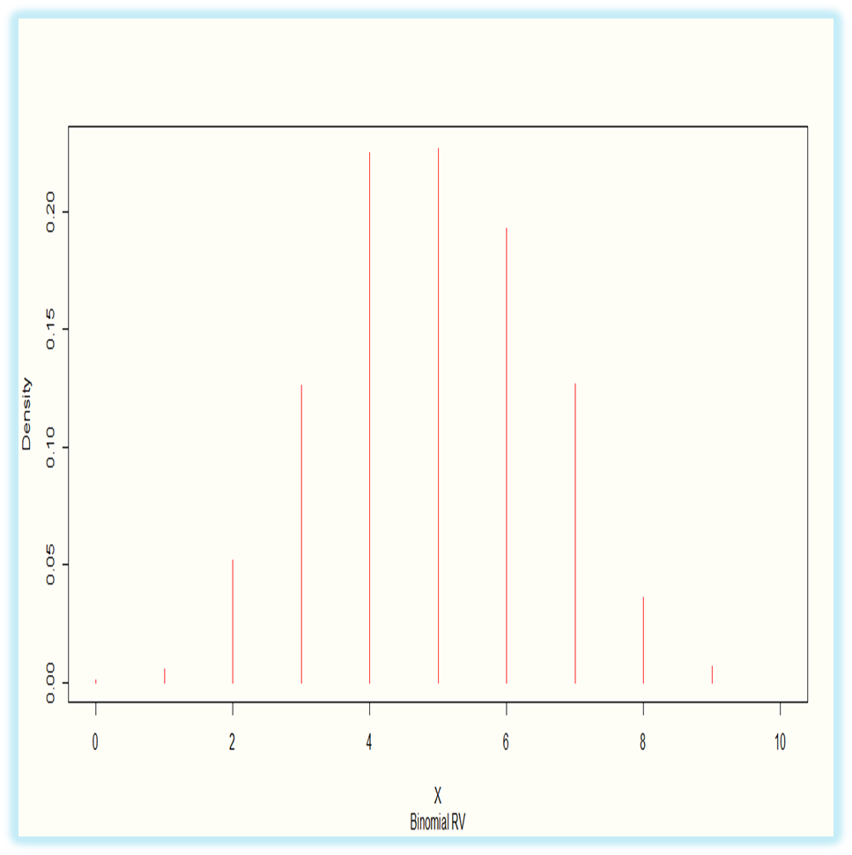
n=10

Slide 32
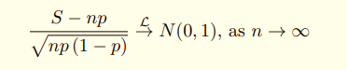
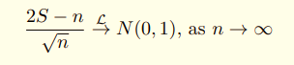
ASYMPTOTIC PROPERTIES OF SIGN STATISTIC :
Under H₀ ,
We compare Relative Frequency plot of the Test Statistic and Normal Curve for various underlying Distributions.

Slide 33
NULL DISTRIBUTION IS F= N(0,1)

Slide 34
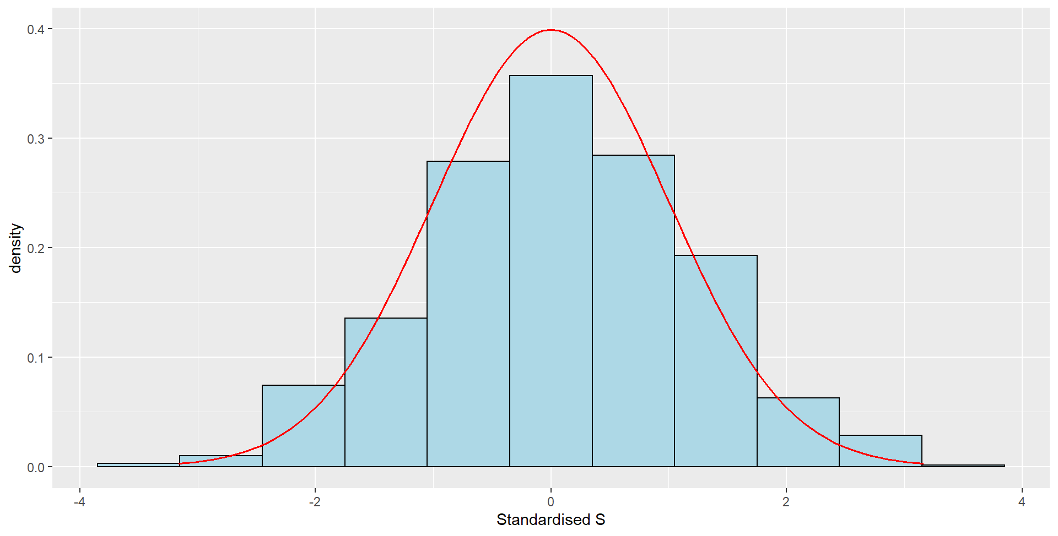
n=10
If we do the density plot of a test statistic with the increase in sample size the assymtotic distribution tends to normal pdf.

Slide 35
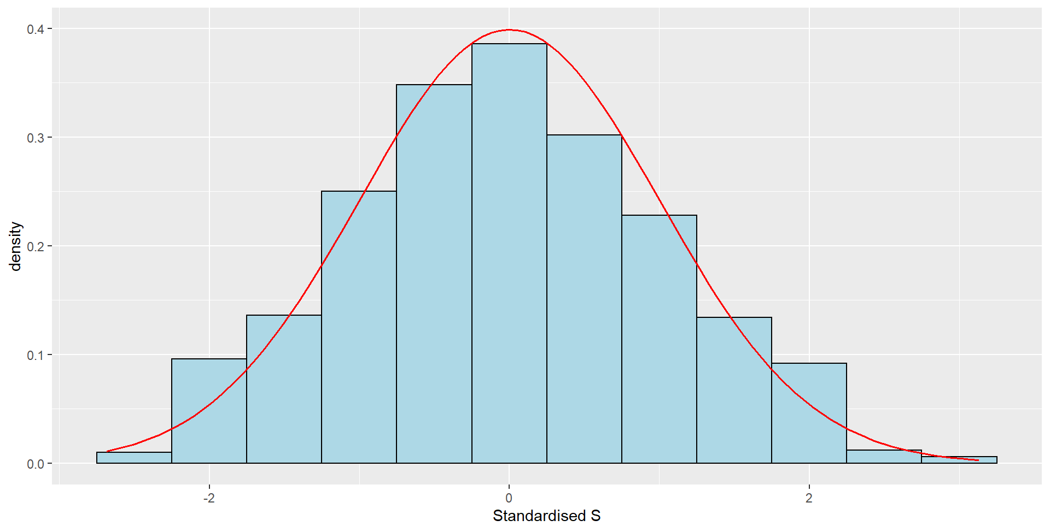
n=20

Slide 36
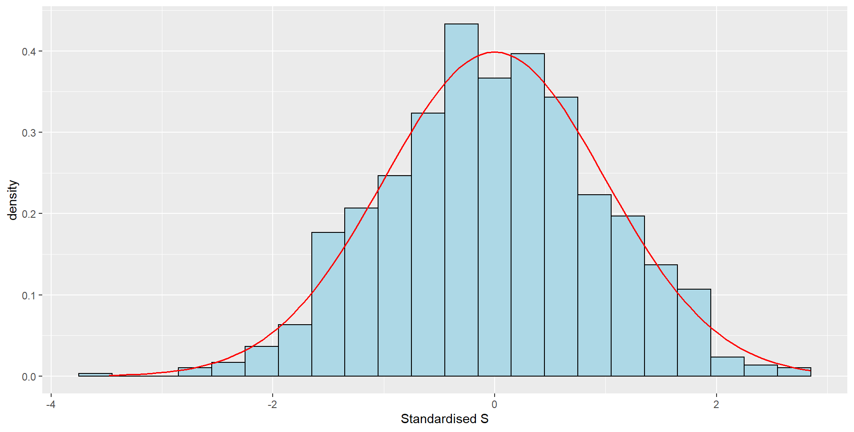
n=40

Slide 37
NULL DISTRIBUTION IS F= DE(0,1)

Slide 38
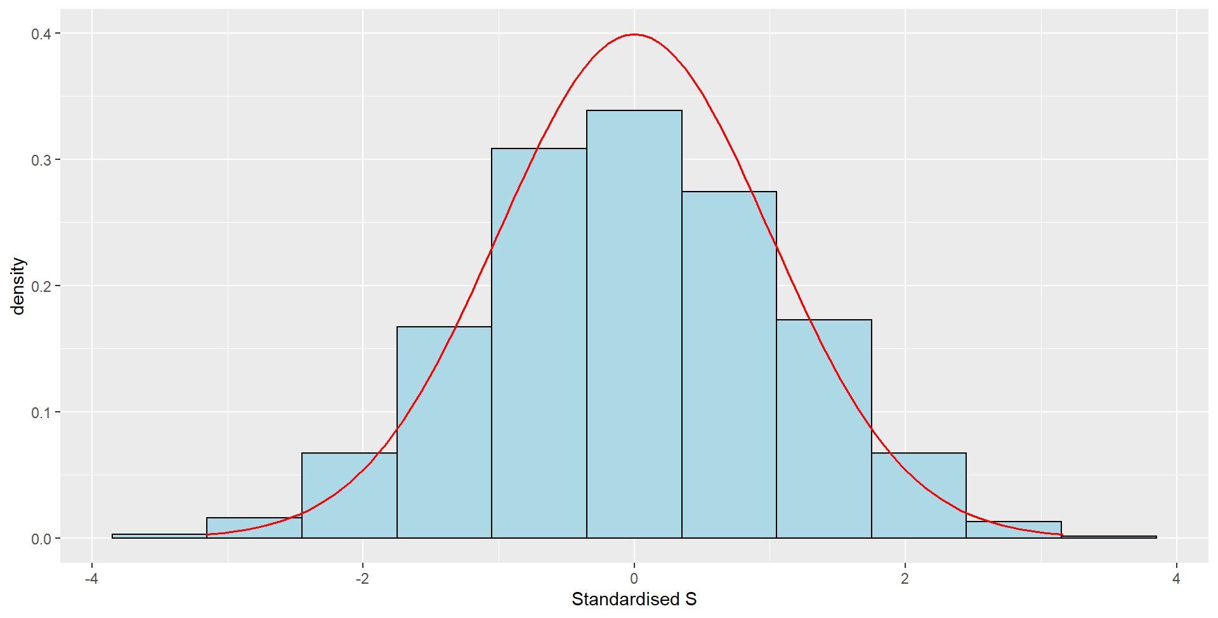
n=10

Slide 39
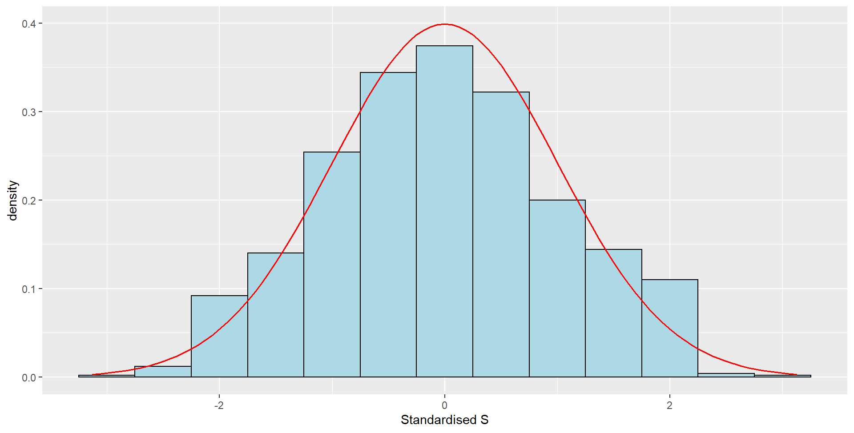
n=20

Slide 40
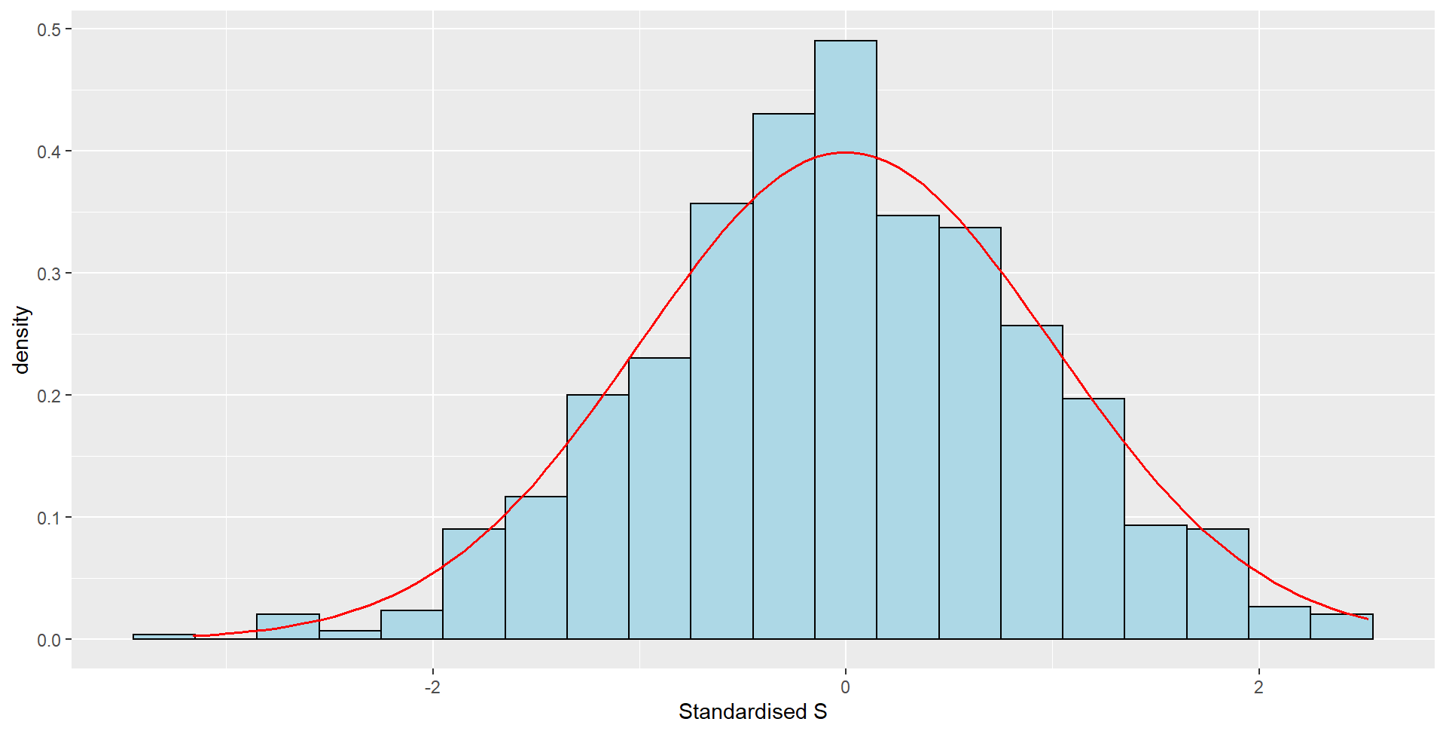
n=40

Slide 41
NULL DISTRIBUTION IS F= Unif(-3,1)

Slide 42
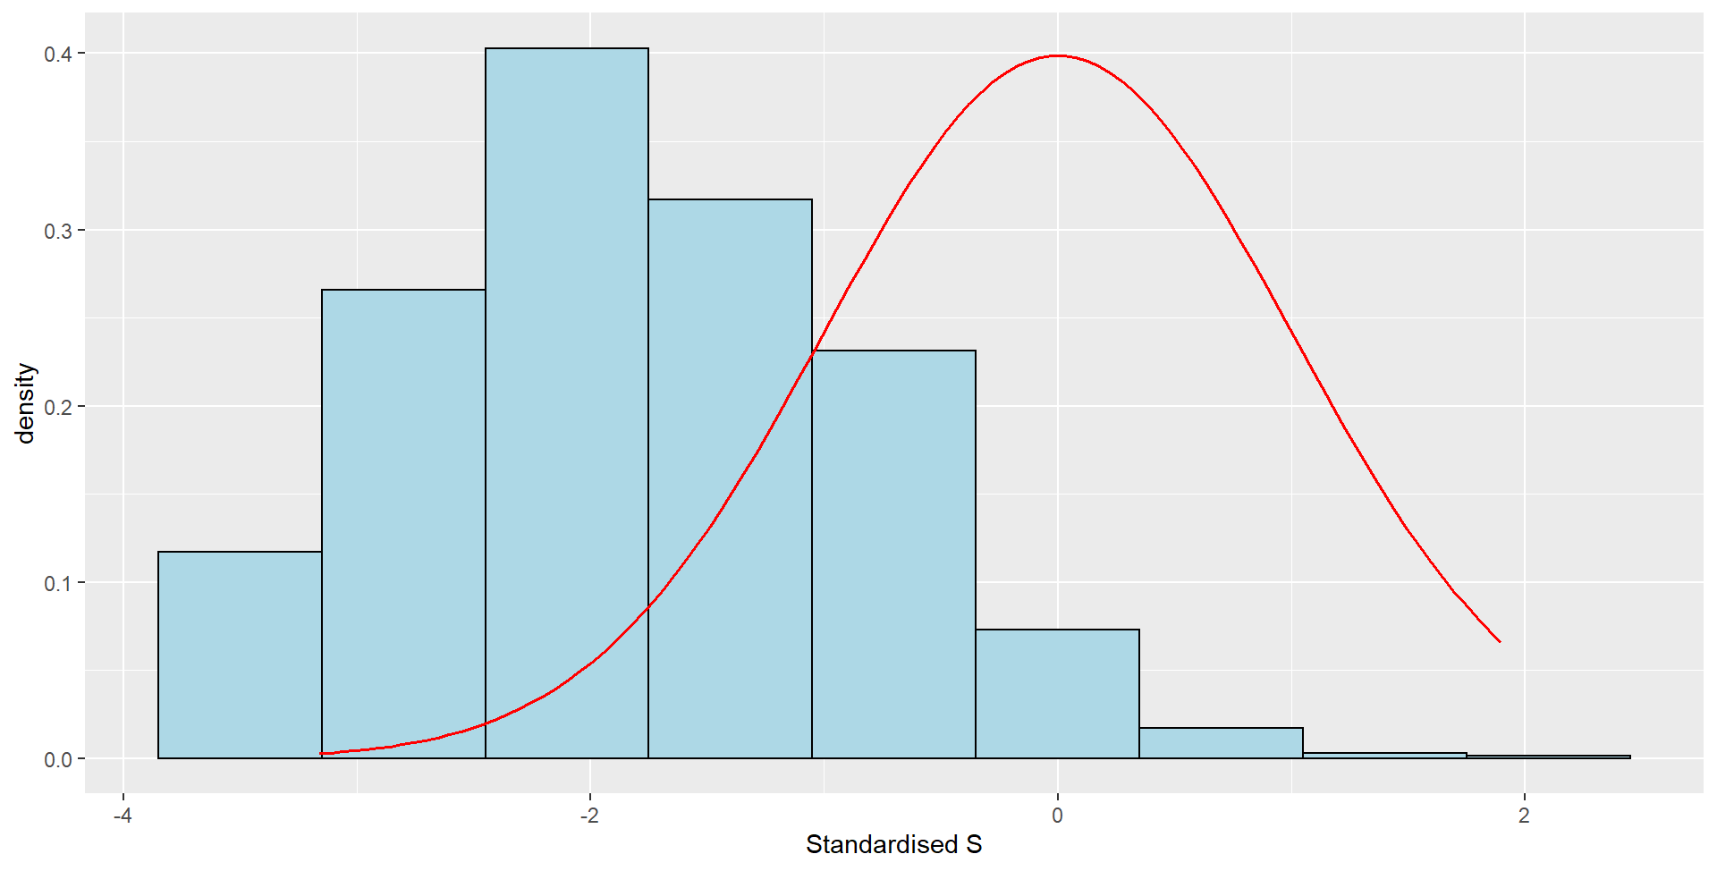
n=10
As uniform(-3,1) is not symmetric about zero so if we standardize the statistic with respect to zero the distribution will not converge to zero.

Slide 43
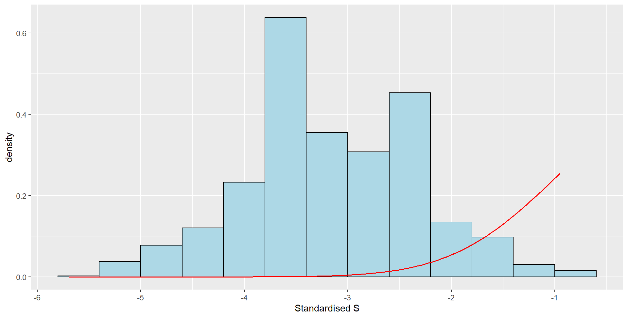
n=40
The same reason is applied for n=40.

Slide 44

Comparison of Sign Tests with Parametric Tests :
Step 1: We take a CDF F(.) and simulate data . On the same data we employ Sign test and t-test (with the hypotheses as specified earlier) .
Step 2: From both the tests at level 0.05, size and power are compared by means of suitable graphical method.

Slide 45

SIZE COMPARISON :

Slide 46

F= N(0,1)

Slide 47
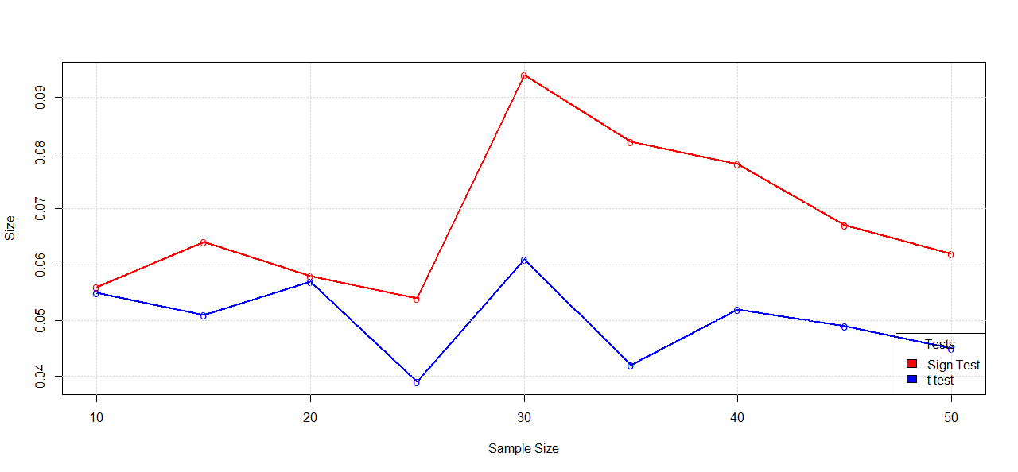
The size of the sign test and t-test both close to 0.05, but for sign test the size is fluctuating more than the t test.

Slide 48
F= Logistic(0,1)

Slide 49
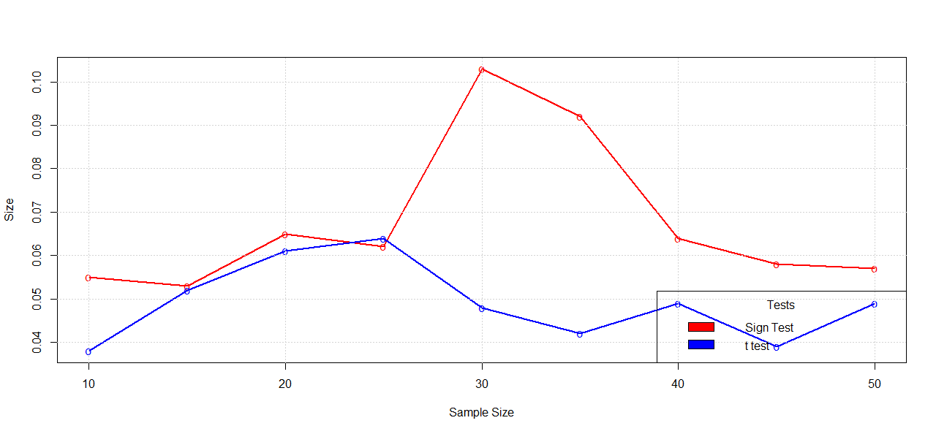
For logistic(0,1) also for the parametric t test the size close to 0.05, due to randomness in some cases the size is higher than 0.05.

Slide 50
F= N(0,1)

Slide 51
The size of the sign test and t-test both close to 0.05, but for sign test the size is fluctuating more than the t test

Slide 52
F= DE(0,1)

Slide 53
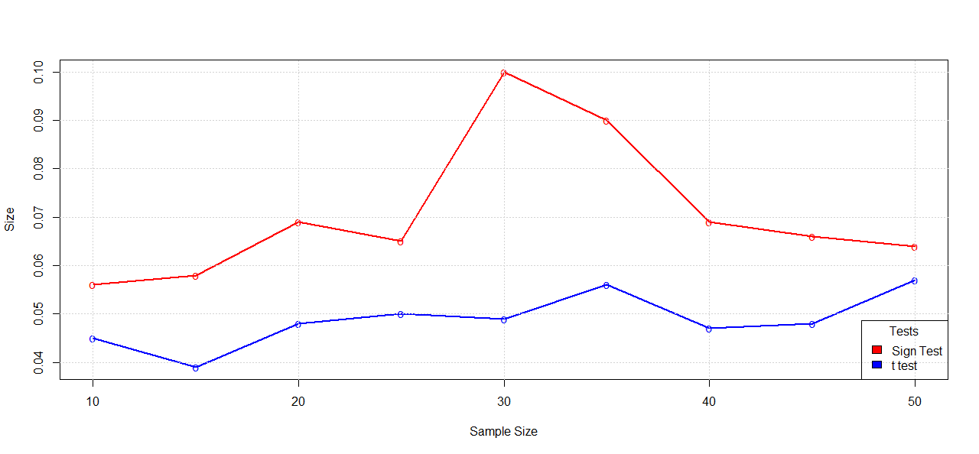
The size of the sign test and t-test both close to 0.05, but for sign test the size is fluctuating more than the t test

Slide 54
F= uniform(-3,1)

Slide 55
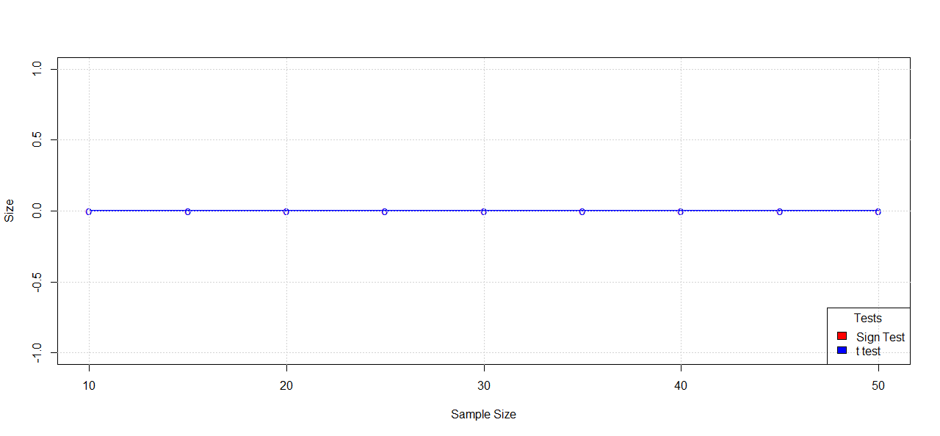
For uniform(-3,1) the size is 0, i.e the type I error is zero.

Slide 56
POWER COMPARISON :

Slide 57
F= N(µ,1)

Slide 58
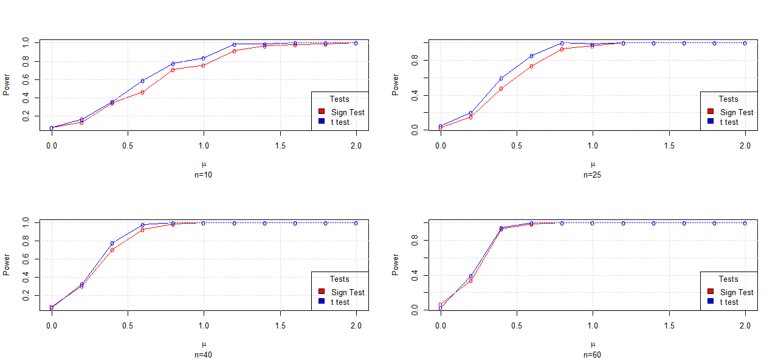
If we compare the power of sign and t test we can see with the increase of n the power converge to 1 at a faster rate and in most of the cases the t test power is higher but with increase of n the size of both test converge.

Slide 59
F=Unif(t-1,t+1)

Slide 60
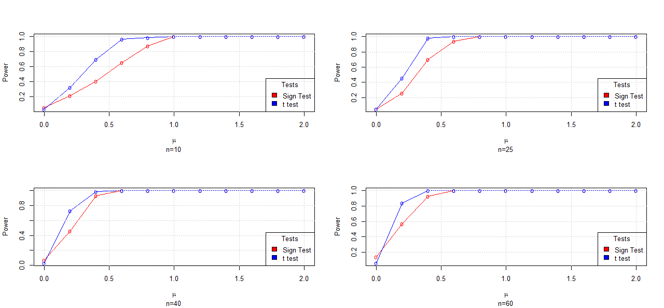
If we compare the power of sign and t test we can see with the increase of n the power converge to 1 at a faster rate and in most of the cases the t test power is higher but with increase of n the size of both test converge.

Slide 61
F= logistic(µ,1)

Slide 62
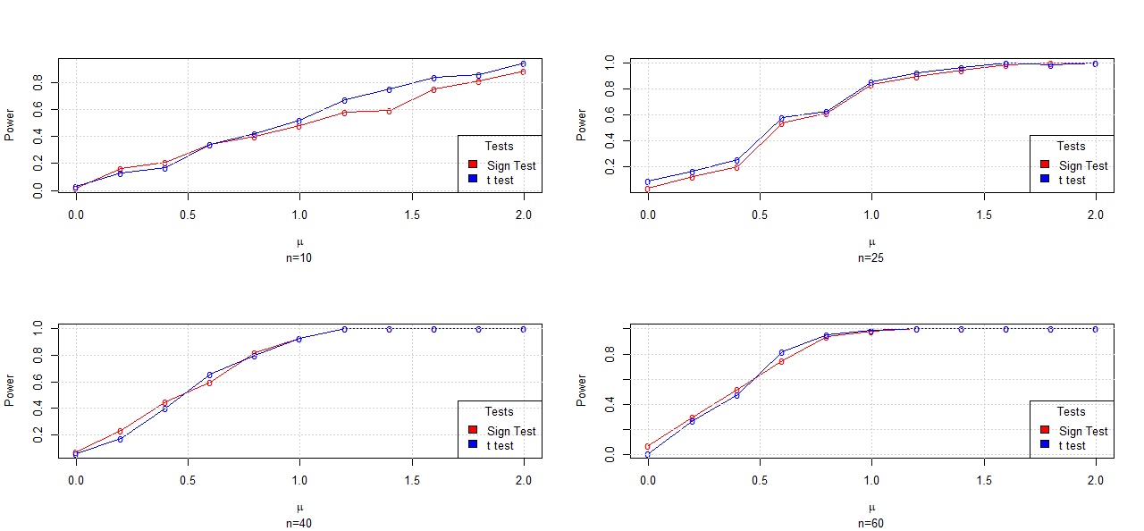
If we compare the power of sign and t test we can see with the increase of n the power converge to 1 at a faster rate and in most of the cases the t test power is higher but with increase of n the size of both test converge.

Slide 63
F= DE(µ,1)

Slide 64
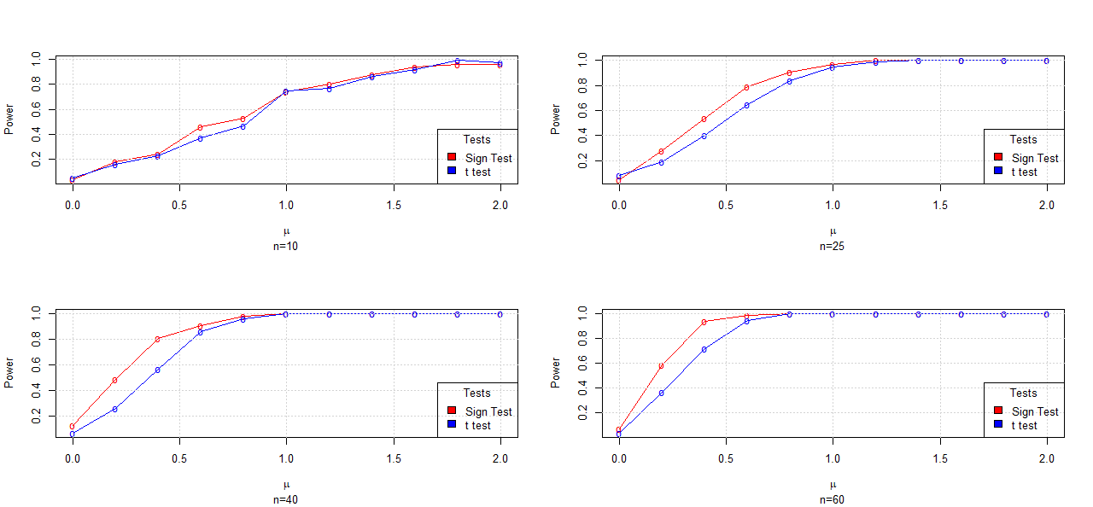
If we compare the power of sign and t test we can see with the increase of n the power converge to 1 at a faster rate and in most of the cases the t test power is higher but with increase of n the size of both test converge.

Slide 65
F=Unif(t-3,t+1)

Slide 66
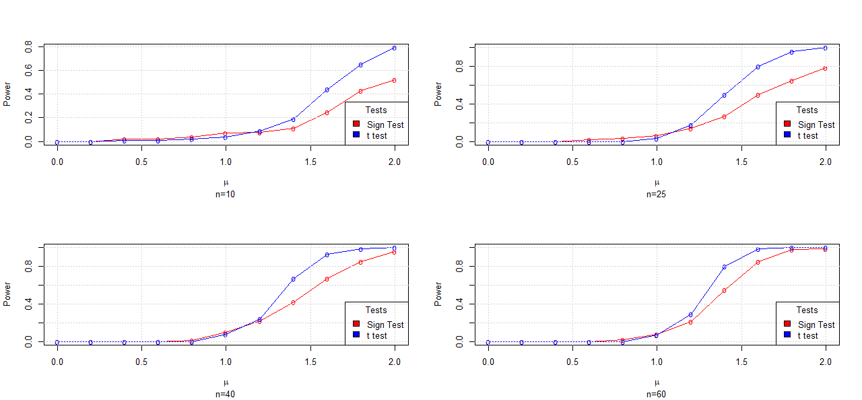
If we compare the power of sign and t test we can see with the increase of n the power converge to 1 at a faster rate and in most of the cases the t test power is higher but with increase of n the size of both test converge.

Slide 67

A REAL LIFE TESTING PROBLEM USING SIGN TEST

